Slide 1
Comparing Threat Types
CompTIA Security+ Exam SY0-701
Lesson 2
Notes:
This lesson covers general concepts associated with threat, vulnerability, and risk.

Slide 2
Objectives
Compare and contrast attributes and motivations of threat actor types
Explain common threat vectors and attack surfaces

Slide 3
Threat Actors
Lesson 2
Topic 2A
Notes:
Students must be able to distinguish vulnerability, threat, risk, and categorize threat actor types for the exam.

Slide 4
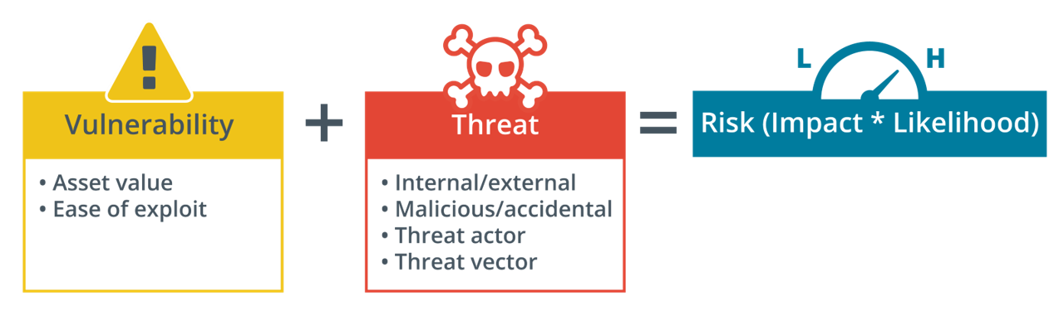
Vulnerability, Threat, and Risk​
Notes:
Make sure students can distinguish these terms and understand how assessment of vulnerability and threat drives calculation of risk.

Slide 5
Attributes of Threat Actors​
Known threats versus adversary behaviors​
Internal/external​
Internal threats have authorized access already
Attribute of threat actor, not where attack takes place
Level of sophistication/capability​
Low capability actors rely on commodity tools​
High capability actors can develop new attacks
Access to political or military assets
Resources/funding​
Notes:
Note that the detailed process of analyzing the threat posed by a particular actor or adversary group is described as threat modeling.

Slide 6
Motivations of Threat Actors
Intent/motivation​
Maliciously targeted versus opportunistic​
Accidental/unintentional​
Strategies
Service disruption, data exfiltration, and disinformation
Chaotic motivations
Financial motivations
Blackmail, extortion, and fraud
Political motivations
Whistleblowers, campaign groups, nation-state actors
Notes:
Discuss how threat sources and motivations change over time. For example, Internet threats have changed from being mostly opportunistic vandalism to structured threats associated with organized crime and state-backed groups.

Slide 7
Hackers and Hacktivists
The “Lone Hacker”​
White hats versus black hats
Authorized versus non-authorized
Unskilled attackers
“Script kiddies​”
Hacker teams and hacktivists​
Notes:
Get students to relate each of these types to capability and motivation.
Terminology such as black/white hat is non-inclusive and is being replaced by neutral terms (unauthorized/authorized).

Slide 8
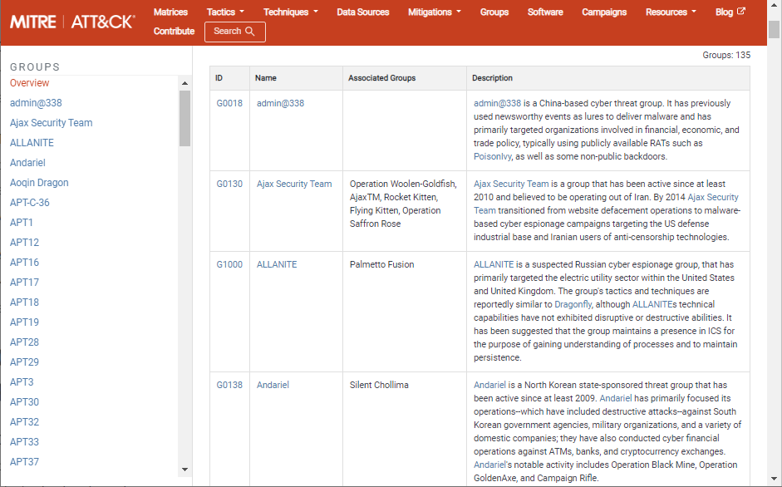
Nation-state Actors and Advanced Persistent Threats​
Attached to military/secret services
High level of capability​
Advanced Persistent Threat (APT)​
Espionage and strategic advantage​
Deniability​
False flag operations​
Screenshot © 2023 The MITRE Corporation. This work is reproduced and distributed with the permission of The MITRE Corporation.
Notes:
Get students to relate this type to intent/motivation and capability.
The Sony hack and WannaCry, both blamed on North Korea, are good examples of state-sponsored attacks.
China's Great Cannon is a good example of how nation-states can deploy significant cybersecurity resources to achieve their aims.

Slide 9
Organized Crime and Competitors
Organized crime
Operate across legal jurisdictions​
Motivated by criminal profit​
Can be very well resourced and funded​
Competitors​
Cyber espionage​ and disinformation
Combine with insider threat​
Notes:
SIM swap fraud is a good illustration of organized crime-type activity.
The Garmin ransomware incident illustrates the blurred lines between organized crime, state groups, and intent/motivation.

Slide 10
Internal Threat Actors​
Malicious internal threat​
Has or has had authorized access​
Employees, contractors, partners​
Sabotage, financial gain, business advantage​
Unintentional insider threat​
Weak policies and procedures​
Weak adherence to policies and procedures​
Lack of training/security awareness​
Shadow IT​
Notes:
The Capital One breaches are good examples of insider threats.

Slide 11
Threat Actors
Vulnerability, threat, and risk​
Attributes of threat actors​
Internal/external, level of sophistication/capability, resources/funding
Motivations of threat actors
Service disruption, data exfiltration, disinformation
Chaotic, financial, political
Hackers and hacktivists
Nation-state actors and advanced persistent threats​
Organized crime and competitors
Internal threat actors​

Slide 12
Attack Surface
Lesson 2
Topic 2B
Notes:
This topic covers the first part of objective 2.2. The human vectors/social engineering subobjective is covered in the next topic.

Slide 13
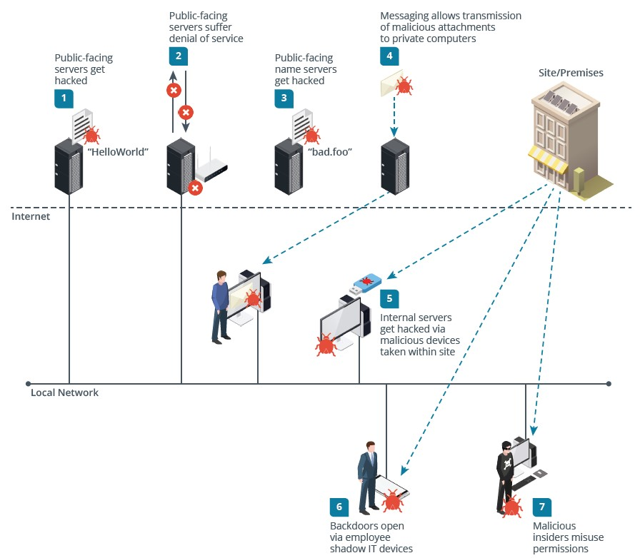
Attack Surface and Vectors​
Attack surface​
Points where an attacker can discover/exploit vulnerabilities
Physical, network, application​, and human surfaces
Whole organization or single system/app scope
Threat vectors​
High capability actors can expand attack surface by developing novel vectors
Notes:
Note that developing new threat vectors is one of the capabilities that distinguishes threat actor groups.

Slide 14
Vulnerable Software Vectors
Vulnerable software
Faults in code or design
Delays and difficulties in patching
Unsupported systems and applications
Client-based vs. agentless
Characteristic of automated vulnerability scanners
Notes:
Develop the idea that many security techniques are dual-use or adversarial: the threat actor will also perform attack surface analysis and vulnerability scanning.
Vulnerability management is covered in detail in a subsequent lesson.

Slide 15
Network Vectors
Remote versus local exploit techniques
Unsecure networks
Lack of confidentiality, integrity, availability
Specific vectors
Direct access and wired (physical ports)
Remote, wireless, cloud, and Bluetooth
Default credentials
Open service port (TCP and UDP ports)
Notes:
This is intended as a brief overview covering the subobjectives associated with the threat vector objective. We'll cover cryptography, IAM, and secure network architecture and operation throughout the rest of the course.

Slide 16
Lure-based Vectors
Bait that will tempt the target into opening it
Removable device
Drop attack
Executable file
Trojan Horse malware
Document files
Macro and scripting technologies
Image files
Viewer/browser vulnerabilities

Slide 17
Message-based Vectors
Email
Short Message Service (SMS)
Instant messaging (IM)
Web and social media
Voice calls
Notes:
Note that these attacks can leverage powerful exploits, such as zero-click, but many technically unsophisticated attacks succeed because they use psychologically effective techniques.
We'll discuss the human vector (social engineering) in more detail in the next topic.

Slide 18
Supply Chain Attack Surface
End-to-end process of designing, manufacturing, and distributing goods and services to a customer
Procurement management
Suppliers, vendors, and business partners
Whole supply chain can be highly complex
Deny threat actors opportunity, time, and resources
Managed service providers (MSPs)
Notes:
Note that there are two main scenarios for evaluating this risk. Most businesses will just focus on using reputable suppliers and being extremely careful about the use of secondhand equipment. Military and secret service type organizations may perform their own audits of suppliers. Remind students about the controversy over Huawei's smartphones and network infrastructure appliances.

Slide 19
Attack Surface
Attack surface and vectors​
Vulnerable software
Network vectors
Remote versus local
Direct access, wired, remote/wireless, cloud, Bluetooth, default credentials, open ports
Lure-based vectors
Devices, programs, documents, images
Message-based vectors
Email, SMS, IM, web/social media
Supply chain attack surface
Design, manufacture, distribution

Slide 20
Social Engineering
Lesson 2
Topic 2C
Notes:
Social engineering is established as a topic at the A+ level, so students should be familiar with the basics. Focus on principles and the specific techniques listed as subobjectives for this exam version.

Slide 21
Human Vectors
“Hacking the human”​
Purposes of social engineering​
Reconnaissance and eliciting information​
Intrusion and gaining unauthorized access​
Many possible scenarios​
Persuade a user to run a malicious file​
Contact a help desk and solicit information​
Gain access to premises and install a monitoring device​
Notes:
Note that social engineering includes written communication as well as face-to-face interaction.
You can refer students to Kevin Mitnick’s books (mitnicksecurity.com) and Bruce Schneier's website (schneier.com/essays/social).

Slide 22

Impersonation and Pretexting​
Impersonation​ means pretending to be someone else​
Persuasiveness/consensus/liking approach
Coercion/threat/urgency approach
Pretexting​
Exploit situations where identity-proofing is difficult​
Using a scenario with convincing additional detail​
Obtain or spoof data that supports the identity claim​

Slide 23
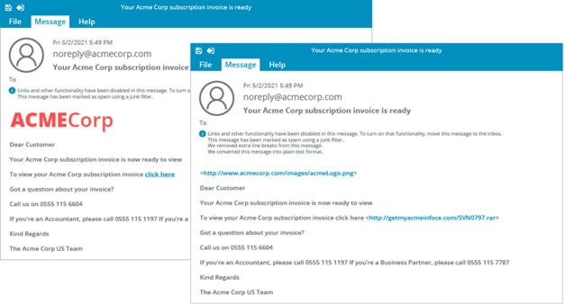
Phishing and Pharming
Phishing
Trick target into using a malicious resource​
Spoof legitimate communications and sites​
Vishing​
Using a voice channel​
SMiShing​
Using text messaging​​
Passive techniques have less risk of detection​
Pharming​
Redirection by DNS spoofing​
Notes:
Some of this terminology is of limited value, but students need to learn it. The basic points are that "phishing" can use any type of communication method to trick the target into interacting with a spoofed resource and can either be general in nature or highly targeted.

Slide 24
Typosquatting​
Make phishing messages more convincing​
Email spoofing techniques
From field confusion
Typosquatting
Cousin domains that look like a trusted domain

Slide 25
Business Email Compromise
Target phishing/vishing/SMiShing to a specific individual
Pose as colleague, business partner, or vendor
Spear phishing, whaling, CEO fraud, angler phishing, …
Brand impersonation and disinformation
Make convincing fake phishing messages, business correspondence, and pharming websites
Disinformation versus misinformation
Watering hole attack
Compromise a third-party site that the threat actor knows is used by the target
Notes:
Machine learning/AI is no longer a subobjective on the 701 exam (they are retained in the acronyms list), but you might want to discuss how the availability of these tools makes it easier for threat actors to develop brand impersonation attacks.

Slide 26
Social Engineering
Social engineering
Human vectors
Impersonation and pretexting​
Phishing and pharming
Typosquatting​
Business email compromise

Slide 27
Summary
CompTIA Security+ Exam SY0-701
Lesson 2
Notes:
Check that students are confident about the content that has been covered. If there is time, revisit any content examples that they have questions about. If you have used all the available time for this lesson block, note the issues and schedule time for a review later in the course.
Split the students into groups and have each identify an instance of one type of threat actor from individual hackers, hacktivist groups, nation-state APT, and organized crime APT. Have each group identify capability and motivation.
For example, the REvil group fit the organized crime profile. They operated a ransomware-as-a-service with a high degree of capability and sophistication with the primary motivation being financial gain. The ransomware was used to attempt extortion via service disruption, notably exploiting a vulnerability in the Kaseya system monitoring product used by many MSPs.

